Slide 1
Protein structure prediction using AlphaFold2
Alper Celik Ph.D.
Centre for computational Medicine
09/08/2022

Slide 2
Outline
PART2​
Looking into AlphaFold2 outputs​
Monomer​
Multimer​
Looking into RosettaFold outputs​
Viewing structures with pymol
Aligning pdb files
Parsing pdb files
Some basic pdb manipulations and calculations using R and python
PART1
What is the CASP challenge
AlphaFold2 model structure
Quick introduction to attention layers and transformers
Evoformer
Invariant point attention
RosettaFold
2 and 3 layer models
Other options
How to run AlphaFold2 and RosettaFold
Some considerations and tips

Slide 3
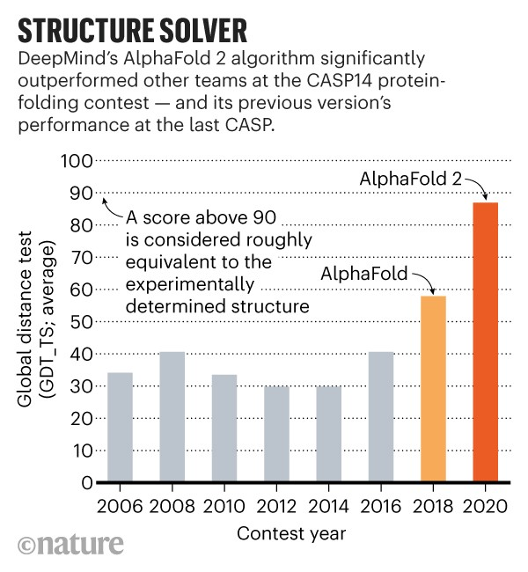
Critical Assessment of Protein Structure Prediction (CASP) challenge
Organized every 2 years
Models are trained using public data but are tested on structures that have not been released to the public
There are several targets of varying difficulty
Small to large proteins
Multimeric proteins/protein complexes
Proteins with metal ions in them
Proteins with unstructured regions
The models are evaluated based on
Comparison of predicted structure to the experimental results
Domain orientations
Reliability at residue and atom level

Slide 4
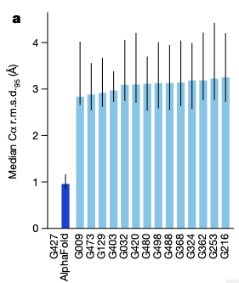
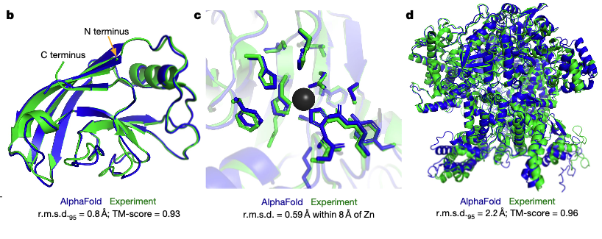
AlphaFold2 is the winner of CASP14 (2020)
AlphaFold2 had a median backbone accuracy of 0.96 Å (1 C atom is about 1.4 Å), whereas the next best method had 2.8Å.
All atom accuracy is around 1.5Å compared to the next best 3.5Å.
Side chain accuracy increases when the model is more confident about the backbone
AlphaFold2
AlphaFold1

Slide 5
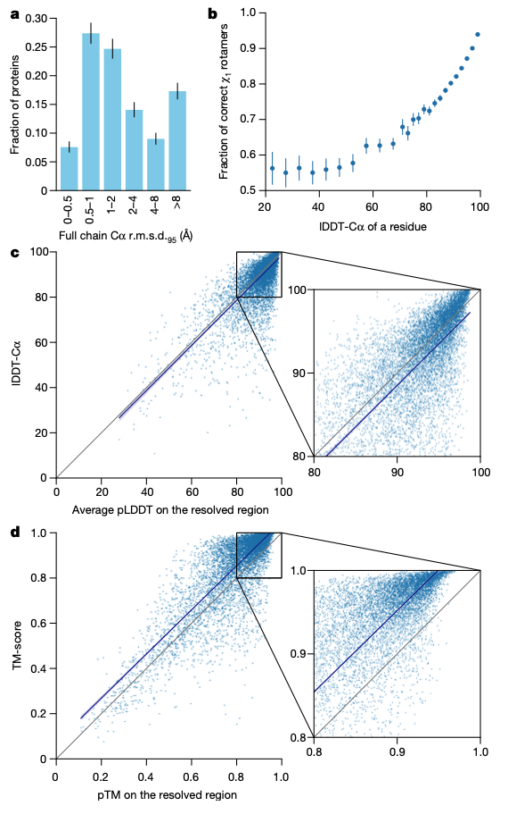
A more detailed look at the performance
Most backbone predictions are within couple of Å (1 C atom is about 1.4 Å).
AlphaFold also outputs a confidence score for each residue (pLDDT) which is higly correlated with the actual outcome

Slide 6
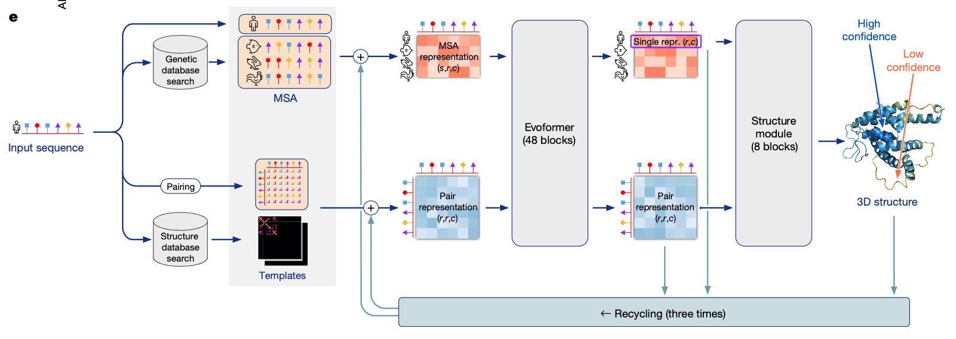
The Model
The model utilizes both multiple sequence alignments (MSA) and known protein structures from PDB to predict the 3D structure
Evoformer is a modified transformer layer that can utilize both the alignment and the structure data
There are hard coded physical constraints in the protein backbone that reflect the biology

Slide 7
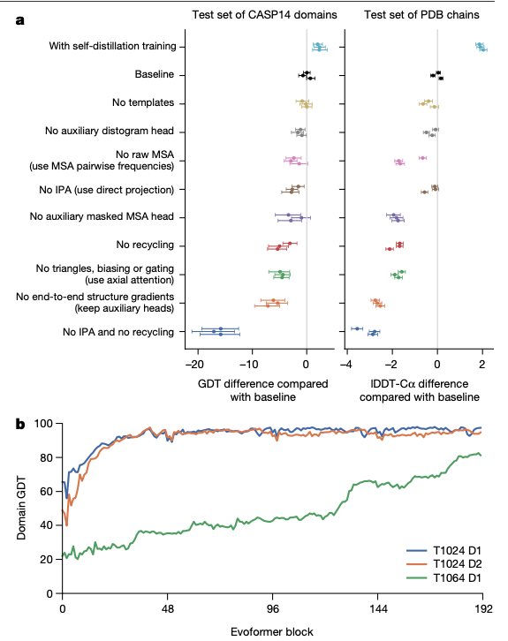
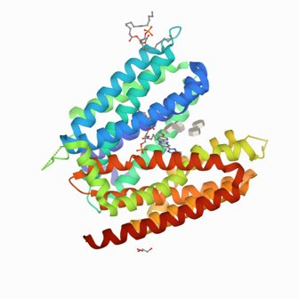
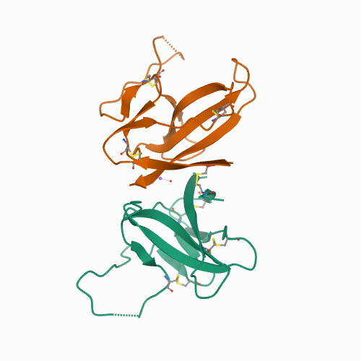
Some components are more important than others
1024 (easy)
1064 (hard)

Slide 8

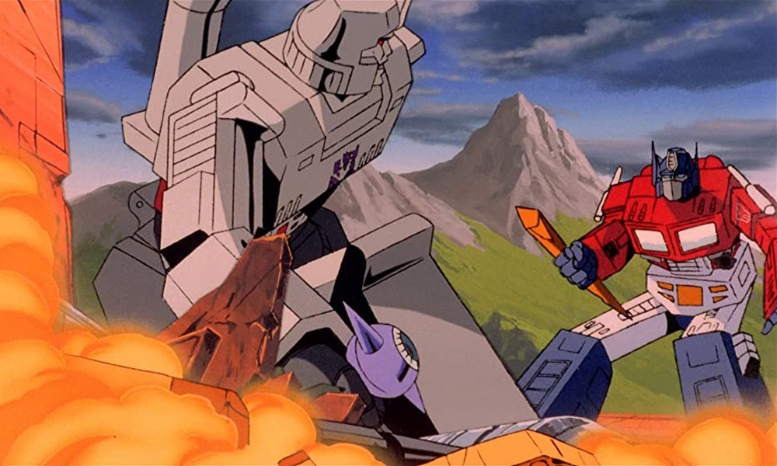
Transformer? Like Optimus Prime?
It's a relatively new type of NN layer that's usually used for transforming an input sequence to an output sequence
Attempts to solve the "vanishing gradient problem".
The encoder layers learns the associations between an item in the sequence with the rest of the items
The decoder generates output sequences from learned relationships, the linear/softmax combination generates the final output probabilities
The decoder pays "attention" to the previous outputs so it can generate the most relevant result in the current iteration
Encoder
Decoder
Notes:
Input embedding is kind of like a lookup table, these are numerical representations of whatever sequence we are working on
Positional embedding is the position information of the input embeddings (where in the sequence they are and how much attention should I pay to this as the sequence progresses)
Encoder than takes this matrix of positions and values and tries to represent them as a continuous representation of learned information
The multi-head attention applies a specific form of attention called self attention, this is to associate each item in the sequence with the rest of the sequence.

Slide 9
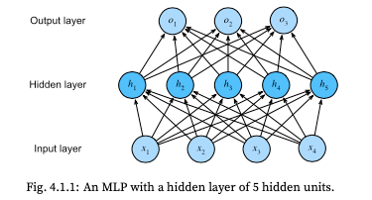
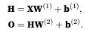
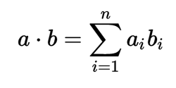
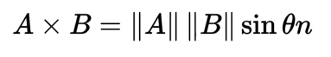
An extremely quick intro to neural networks
A neural network is a collection of weights and biases that get updated with each iteration of learning
The idea is to create a large collection of linear terms to approximate arbitrary non-linear relationships
Information is passed from layer to layer in terms of neuron activations and weight/bias updates
More sophisticated structures are achieved through
Concatenation of matrices
Element wise addition/multiplication
Cross/dot products
Dot product
Cross product
Notes:
There are some drawback to this approach
They are extremely computationally intensive, that's why they have not been popular before
They are very easy to overfit

Slide 10
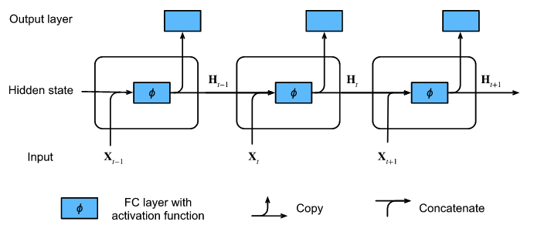
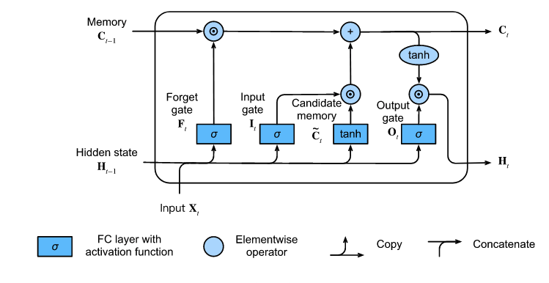
Processing sequence info, recurrent neural nets
Before the invention of attention layers recurrent networks were the default choice for sequence data (text, time series etc.)
We model the history as a latent variable
This gets updated at each time point
Keeps the # of variables to learn low(-ish)
Suffers from vanishing gradient problem
There are many "flavors" that tries to combat this problem (e.g. LSTMs)
Notes:
Before the invention of attention layers recurrent networks and their derivations dominated the natural language neural network models. These networks instead of passing the whole history of the sequence model they instead contain an hidden state that tries to learn an latent variable about the previous steps. I'm not going to go into details about how RNNs or its derivatives work, however you can imagine that as the sequence gets longer it becomes more difficult to retain information about the past steps. We are dealing with probabilities and as you keep multiplying theses they eventually become 0. This the vanishing gradient problem.

Slide 11
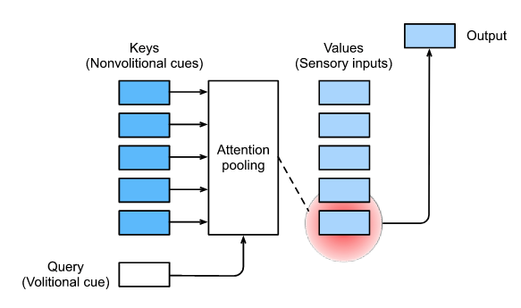
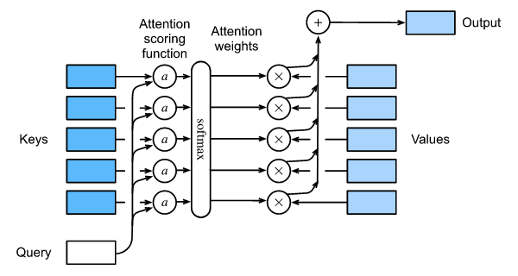
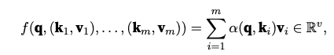
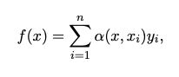
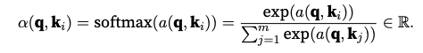
A quick introduction to attention layers and transformers
Notes:
In the RNN example we were paying attention to the whole data while trying to calculate the learnable latent variable. What if instead we came up with a method to filter out the noise. In the context of attention mechanisms these the non-noise as the query, think of this as a volitional cue, like how you are choosing to pay attention (I hope) to me instead of many other sensory inputs that you are recieving. Given a query attention mechianism biases the selection of inputs (values). These inputs are not raw data points but rather some sort of processed values that are in the network. Each of these values also have a key, they can be thought as the entirety of the surrounding (noise and non-noise included).
There are many ways we can generate queries, a gaussian kernel, a weighted average or some other linear or non-linear transformation. The point is to find a way to reduce the number of things we need to rememmber and bias the selection of what really matters in the next point in the sequence. This is accomplished with the attention scoring function, this take the values and the query and prodcuses a score, we can then use some sort of selection (softmax for multiclass or logit for binary) to bias the selection of keys. The attention scoring function can also take many form, they can be additivie, multiplicative or any other transformation you can think of.
Simple attention layer

Slide 12
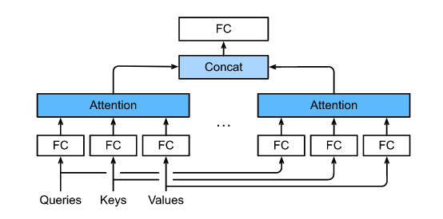
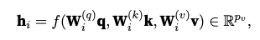
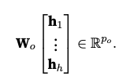
Multi-Head Attention, more is more
Notes:
The attention mechanims brings 2 advantages and one disatvantage
1. We no longer need to worry about vanishing or exploding gradients, we have a fixed (but very large) dimension of features that we can learn, but what's more important is that we have a way of learning the important bits of the latent variables and ignore (or not pay as much attention) others.
2. The other improvement is more on the computational side with a recurrent layer, if you are familiart with MCMC this may have already occurred to you, we cannot process time t without processing t-1 we have to do it in order, we (as in people who write linear algebra code) spent a lot of time optimizing and parallelizing matrix operations and now we have a matrix of features that we can add, concat, multiply with these optimized libraries
The disadvantage is we are losing position information, in a recurrent network since we are processing one word, one letter at a time the position information is implide so we need to find a way to re-add the position information

Slide 13
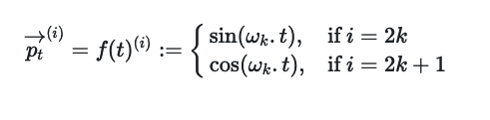
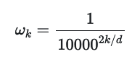
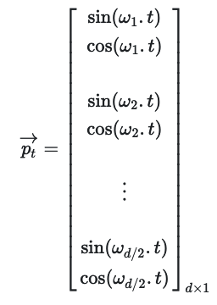
Positional encoding
Because we are now processing all the inputs at the same time we need to add back the position information
We can create another vector the same length as the embedding
Using a sine (or cosine) we limit the range of the values that can be used
Using a vector of different frequencies, we can create a length invariant embedding vector of fixed values whose magnitude do not depend on location

Slide 14
Putting it all together, Transformer Layer
Here we are showing an encoder-decoder architecture, but you can mix and match these components
​
If you need to:
Predict something about your sequence you do not need the decoder​
Generate some sequence based on features (the opposite of prediction) you do not need the encoder​
Input a sequence and get another sequence (like translation) you need both
Notes:
Here we are showing an encoder-decoder architecture but you can mix and match these models
If you need to just predict something about your sequence you do not need the decoder
If you need to generate some sequence based on features (the opposite of prediction) you do not need the encoder
If you need to input a sequence and get another sequence (like translation) you need both
There are couple of things we skipped like the Add&Norm layer and the Feed Forward layer, these are pretty standard normalization and feature learning methods commonly used in deep learning. The normalization is there to keep the values in check (not too small, not too big), the feed forward is there as another transformation to introduce another layer of non-linearity.

Slide 15
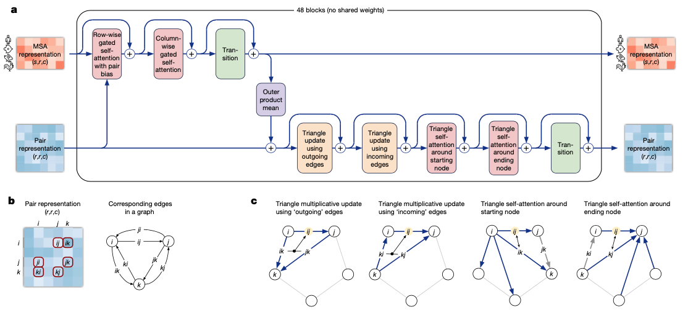
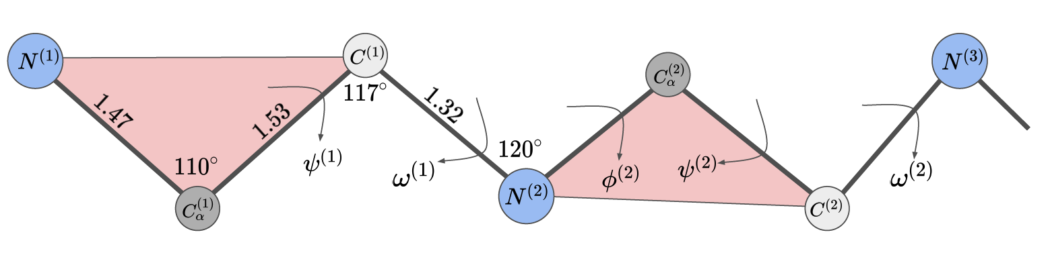
Back to Evoformer, what's the difference?
Both the MSA and the pair representation of the sequence is fed into the evoformer.
There are 2 main differences between the evoformer and the classic transformer
Evoformer uses the MSA to gain more insight into the "context" of the aa sequence
The triangle updates constrain the model to mimic the backbone of the protein

Slide 16
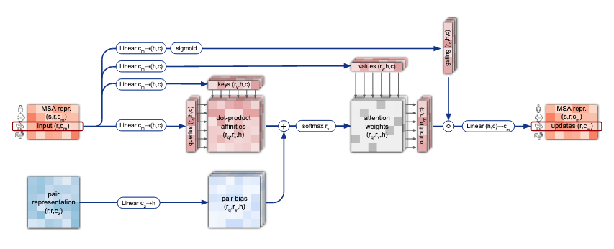
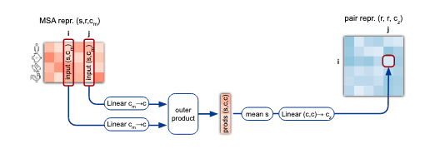
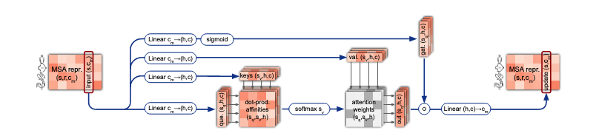
Evoformer in a little bit more detail
Row wise attention
There are 3 sections to the Evoformer block
Row-wise attention, takes the pair represnetation (aa distances) and the MSA to generates weights for residue pairs
Column-wise attention lets elements that belong to the same target residue exchange information
These two are then connected with an outer product and the information is used to update the pair representation
The updated pair representation is passed to the triangle update
Column-wise attention
Notes:
There are 48 evoformer blocks
We start with the MSA, this is going to be the main data we will be using to "learn" the "language" of proteins. Each block has a an MSA representation and pair reprsenstation of the sequence (this is training so we have the 3d strucutre) during inference this starts as random weights. The row wise MSA becomes has the self attention queries and keys and another attention had has the values but before we use the values we have item wise addition/softmax from the structure pair representation
Similarly there is a column wise attention. This

Slide 17
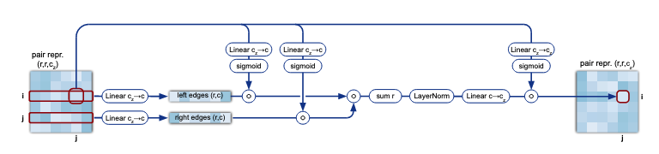
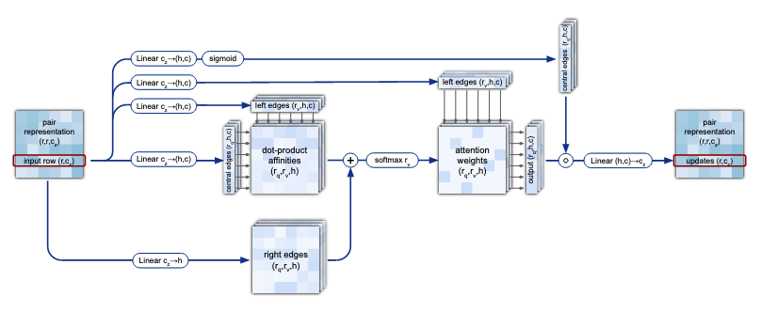
Evoformer in a little bit more detail
Triangular update
3rd step Triangular update
The pair representation is refined by combining information within each triangle for edges ij, ik and jk for residues i,j and k.
The triangular self attention updates the pair representation based on the graph that is updated above
Triangular self-attention

Slide 18
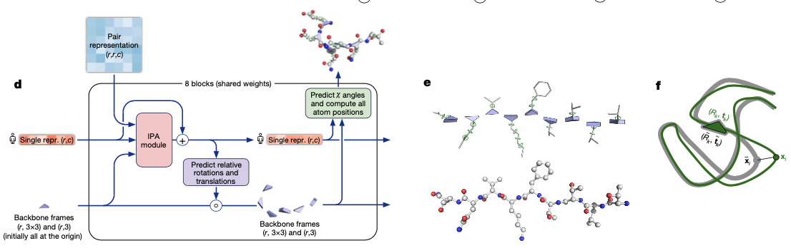
The structure module
Single representation is the original AA sequence
This module maps the abstract representations in evoformer to actual 3D space
Constraining the backbone significantly reduces the search space
Invariant point attention (IPA) is also new kind of attention module that is geometry aware meaning, the residues are updated (rotated, stretched etc.) w/o changing their locations
After all the training and learning we start again (3 more times 4 cycles total) to refine the model

Slide 19
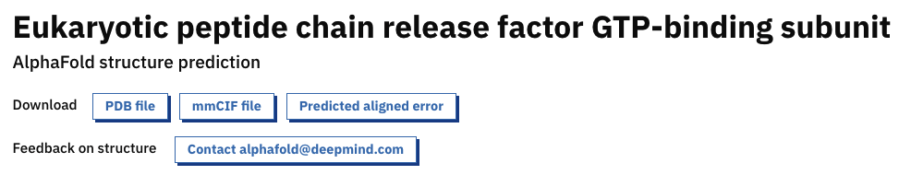
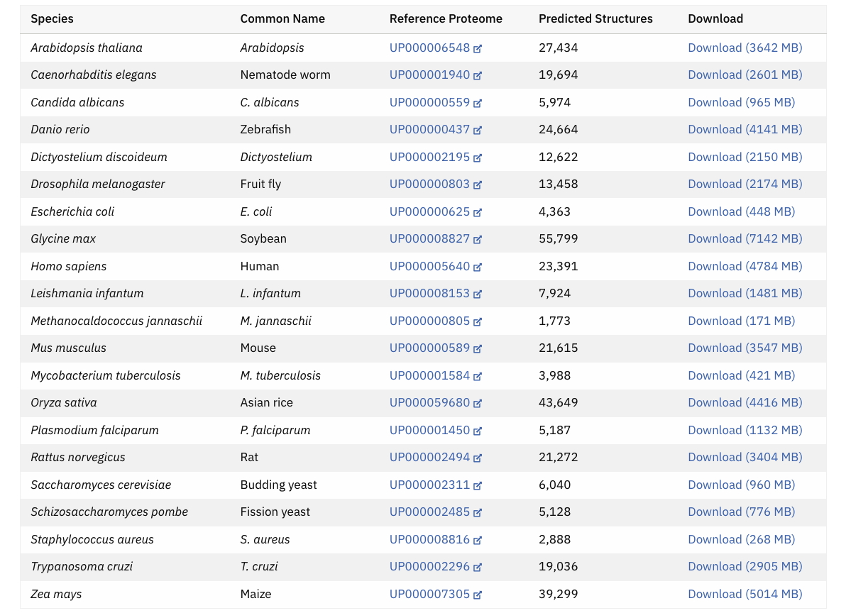
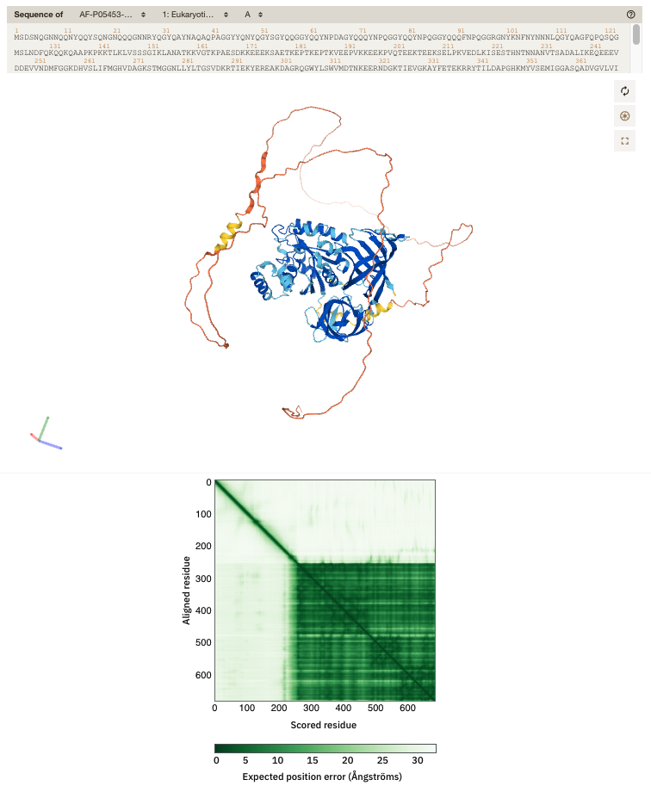
Ok, but do I need to run AlphaFold2 for my favorite protein?
Notes:
https://alphafold.ebi.ac.uk/

Slide 20
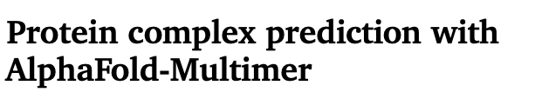
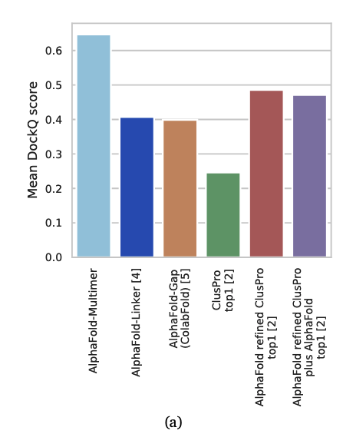
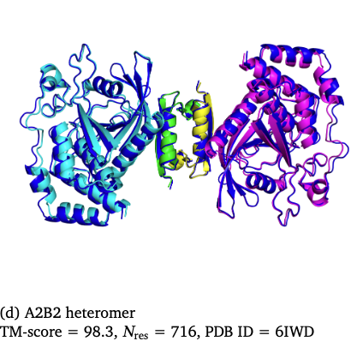
I love proteins, but I love protein complexes more
Prior to alphafold multimer there were several attempts to solve this problem using AlphaFold2. These included:
Adding a flexible linker
Adding Xs
Changing aa residue # in the MSA
Using uniprot data manages to improve accuracy of multimer (both homomer and heteromer) accuracy.
This is installed in HPF under alphafold_multimer
Notes:
https://www.biorxiv.org/content/biorxiv/early/2021/10/04/2021.10.04.463034.full.pdf

Slide 21
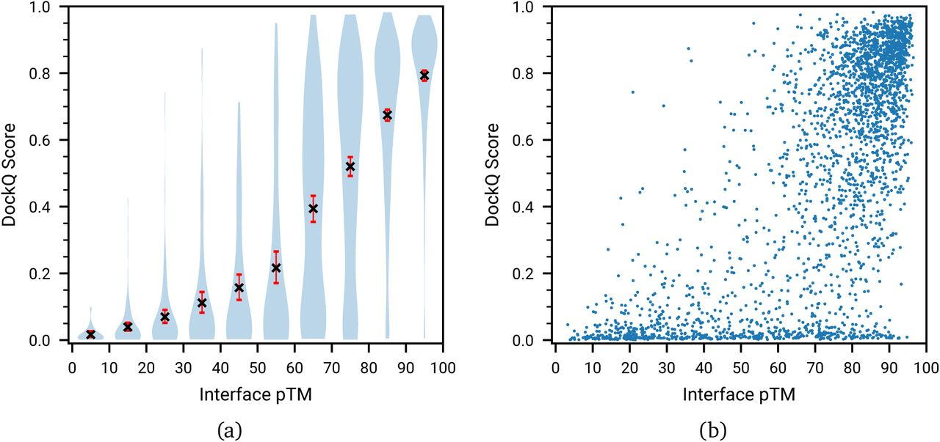
Modifications to the original model to accommodate multimers
MSA procedure was altered slightly to accommodate multiple proteins
Increased the loss function cutoff to accommodate intra-chain interactions
Chains are pushed apart with a new loss function to homomers are not on top of each other
New model confidence score interface pTM (iPTM)
Developed a new algorithm to account for different permutations of heteromers (e.g. AAB vs ABA vs BAA)

Slide 22
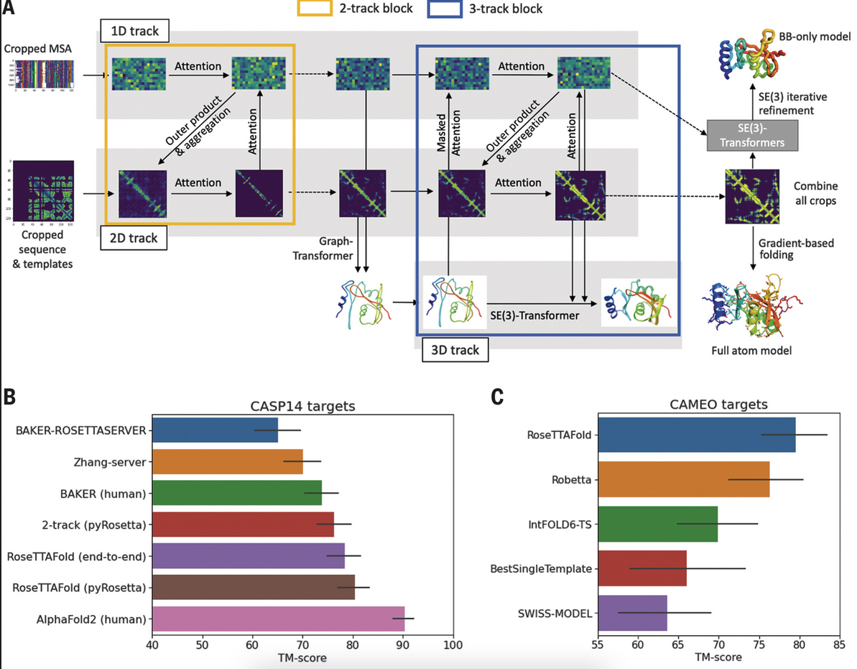
AlphaFold2 is not the only game in town
Rosetta fold is lighter alternative to AlphaFold2
It is not as accurate as AlphaFold2
It has a similar transformer architecture but does not have the IPA module
Requires a lot less storage (~300GB) and has much lower hardware needs (hours of compute time with a RTX 2080)
Installed under hpf as RoseTTAFold/20211019
Notes:
https://www.science.org/doi/abs/10.1126/science.abj8754
https://github.com/RosettaCommons/RoseTTAFold

Slide 23
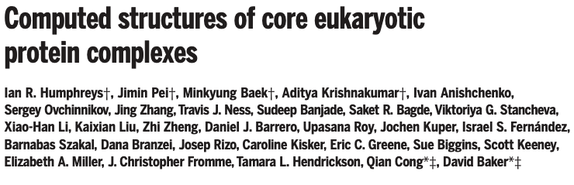
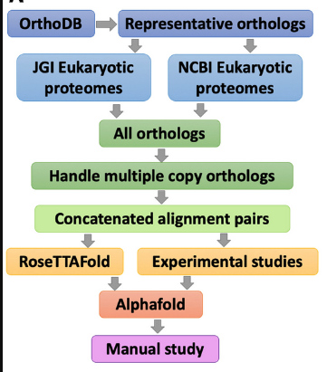
You can also predict complexes with RosettaFold, kind of, maybe, if you're lucky
Used yeast proteome because it's simpler (no splicing, isoforms)
Relies of co-evolution of binding partners
Used orthologous proteins to figure out which parts of the interacting pairs are likely to be interacting
Used a 2-track rosettafold model to predict initial structures (due to compute and time constraints)
After filtering out low-confidence pairs used AlphaFold to predict the complex
Notes:
Multimer predictions with rosetta

Slide 24
There are even more options: FastFold and OpenFold
Fast Fold
https://github.com/hpcaitech/FastFold
Increased GPU performance by using several optimization methods
Uses the same weights as AlphaFold2
Multi-GPU inference
Automatic detection of parallelization
Re-implemented in pytorch instead of JAX
There is a enviroment.yaml for easy conda set up
Open Fold
https://github.com/aqlaboratory/openfold
Increased GPU performance
Reduced vram (they say 4000aa on a single A100)
Custom cuda code to improve attention layers
More streamlined MSA
There are training and inference scripts
Uses the same weights as alphafold (unless you re-train)

Slide 25
That's great, but how do I run the thing?
Currently you have 3 options:
Run it on HPF:
Pros:
We have some decent hardware (NVIDIA V100 32GB Telsa GPU)
You can specify up to 170 GB of RAM on the gpu queues
Gpu queues also support interactive sessions (still no internet connection)
We have 2 different AlphaFold2 releases installed (but not fully tested)
Cons:
AlphaFold2 is installed as a container, you cannot change the runtime parameters other than those are available in the command interface
If the queue is busy it might take some time for the job to be picked up
Run it on GoogleColab:
Pros:
There are colab notebooks that make running trivial
It runs on google hardware so there is no shortage of gpus
Cons:
If the free tier is not robust enough for you (the gpus are not that great) you might need to pay
You can only use the reduced dbs (unless you create your own notebook)
There is no support (from Sickkids or google)
If there is sensitive information there might be regulatory issues
Run it on your computer:
Pros:
You know exactly what's going on and can control every aspect of the process
Cons:
Installation w/o docker is tricky
Requires some expertise to get it going
You need a good NVIDIA gpu that is at least CUDA10 capable
You are going to need lots of ram (128GB or more)
You are going to need a lot of storage (2.5 TB just for installing)

Slide 26
Run it on HPF
AlphaFold2
Running the monomer pipeline
Single protein
>sequence_1
<SEQUENCE A>
#!/bin/bash #PBS -q gpu #PBS -l nodes=1:ppn=9:gpus=1,mem=160gb,walltime=24:00:00
module load alphafold/2.1.1_multimer
alphafold --fasta_paths=fasta1.fa,fasta2.fa \ --output_dir=$outdir \
--max_template_date=2020-05-14 \
--data_dir=$data \
--uniref90_database_path=$uniref90 \
--mgnify_database_path=$mgnify \
--pdb70_database_path=$pdb70 \
--bfd_database_path=$bfd \
--uniclust30_database_path=$uniclust30 \
--template_mmcif_dir=$mmcif \
--uniprot_database_path=$uniprot \
--obsolete_pdbs_path=$obsolete_pdbs \
--model_preset=monomer \
--db_preset=full_dbs \
--use_precomputed_msas \
There are 3 different monomer options:
monomer: (this is the default) generates 5 models (and unrelaxed models)
monomer_ptm: less accurate but also generates inter domain ptm scores
monomer_casp14: original casp14 model runs an ensembl of 8 models (takes a long time for little gain in accuracy, not recommended), needs the uniprot database
For both pipelines you can specify full_dbs or reduced_dbs in db_preset

Slide 27
Run it on HPF
AlphaFold2
Running the multimer pipeline
#!/bin/bash #PBS -q gpu #PBS -l nodes=1:ppn=9:gpus=1,mem=160gb,walltime=24:00:00
module load alphafold/2.1.1_multimer
alphafold --fasta_paths=fasta1.fa,fasta2.fa \ --is_prokaryote_list=true,false \ --output_dir=$outdir \ --max_template_date=2020-05-14 \ --data_dir=$data \ --uniref90_database_path=$uniref90 \ --mgnify_database_path=$mgnify \ --bfd_database_path=$bfd \ --pdb_seqres_database_path=$pdb_seqres \ --uniprot_database_path=$uniprot \ --uniclust30_database_path=$uniclust \ --template_mmcif_dir=$mmcif \ --obsolete_pdbs_path=$obsolete_pdbs \ --model_preset=multimer \ --db_preset=full_dbs \ --use_precomputed_msas \
Homomer with 3 identical subunits
>sequence_1
<SEQUENCE>
>sequence_2
<SEQUENCE>
>sequence_3
<SEQUENCE>
Heteromer with A2B3 stoichiometry
>sequence_1
<SEQUENCE A>
>sequence_2
<SEQUENCE A>
>sequence_3
<SEQUENCE B>
>sequence_4
<SEQUENCE B> >
sequence_5
<SEQUENCE B>

Slide 28
Run it on HPF
RosettaFold
Single protein
>sequence_1
<SEQUENCE A>
#!/bin/bash​ #PBS -q gpu​ #PBS -l nodes=1:ppn=9:gpus=1,mem=160gb,walltime=24:00:00​
module load RoseTTAFold/20211019
mkdir -p rosetta/${file%.fasta}
run_pyrosetta_ver.sh $file rosetta/${file%.fasta}
OR
run_e2e_ver.sh $file rosetta/${file%.fasta}
For pyrosetta version there will be 5 models with different confidence scores
For e2e version (end to end) there will be a single model

Slide 29
The variables:
data=$ALPHAFOLD_DATA # the enviromental variable is loaded with the module​
uniref90=$data/uniref90/uniref90.fasta​
mgnify=$data/mgnify/mgy_clusters.fa​
bfd=$data/bfd/bfd_metaclust_clu_complete_id30_c90_final_seq.sorted_opt​
pdb_seqres=$data/pdb_seqres/pdb_seqres.txt​
uniprot=$data/uniprot/uniprot.fasta​
uniclust=$data/uniclust30/uniclust30_2018_08/uniclust30_2018_08​
mmcif=$data/pdb_mmcif/mmcif_files​
obsolete_pdbs=$data/pdb_mmcif/obsolete.dat​
pdb70=$data/pdb70/pdb70​

Slide 30
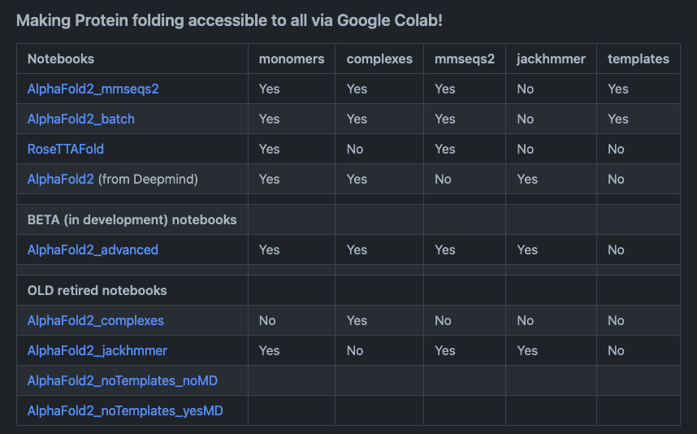
Run it on Google Colab
There are several Google Colab notebooks to choose from (including one from deepmind) with different features implemented.
All of them only use the small bfd database to improve speed at the cost of accuracy.
Notes:
https://github.com/sokrypton/ColabFold

Slide 31
Run it on your computer
RosettaFold
~ 300 GB of free space
CUDA10 compatible GPU (11 is better)
More vram the better, you might be able to predict smaller proteins with a 2080 super but a 3090 (or multiple nvlinked 3090s) would be better
Doesn't require a lot of RAM (more is better)
Installation instructions in the github profile
There is no official docker image but can be created using the installation instructions
AlphaFold2
~ 3 TB of free space
A lot of RAM (no official number but MSA step uses a lot of RAM)
CUDA11 compatible GPU
With a lot of VRAM for larger proteins (for it to be useful you would need at least one RTX3090 better if you can nvlink)
There is a Dockerfile
There are couple of tricky requirements
Jax doesn’t always recognize GPUs even when tensorflow does
CPU needs to be compatible with AVX-512 instruction sets

Slide 32
Some considerations and tips:
Accuracy of AlphaFold2 predictions depends on how many MSA hits there are and how diverse they are
Runtime and memory usage is proportional to (# of amino acids in your protein)²
For multimer you need to know the stoichiometry of your complex (or at least have some idea to try couple of things)
For large proteins (>1000, 1200 aa) you will most likely run out of GPU memory in HPF (while V100s have 32GB memory not all of that is available to the model)
For very popular proteins the MSA can be very large and consume a lot of memory
Multimer pipeline takes a long time to run plan accordingly (max walltime on gpu nodes in 10 days)
Amber relaxation sometimes gives a cryptic error
For interpretation of results
For backbone >70 pLDDT is considered decent, >90 close to experimental results
For side chains interpretation is not reliable for backbone confidence <90

Slide 33
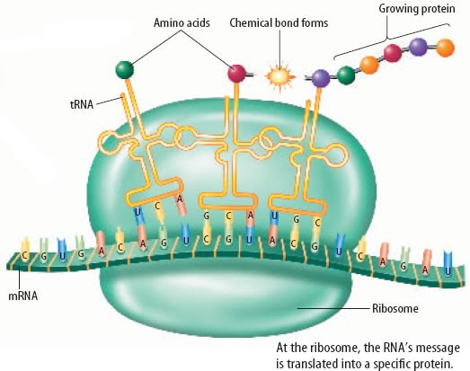
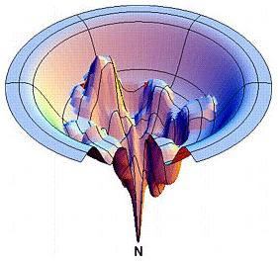
Limitations of these predictions
Protein folding happens during translation
AF2 and RosettaFold (and other) do not consider the sequential aspect of protein folding
They struggle with multi-domain proteins (especially if there are flexible linkers)
They do not consider the thermodynamics of folding
There is no information about ligands, ions, active sites are predicted through conserved sequences/structures
There is no information about transmembrane domains
Trained to predict single structures
The biases present in x-ray structures are also embedded in predictions
Notes:
While these predictions are extremely useful it is not w/o limitation
The most obvious ones is the prediction accuracies for multi-domain proteins, both AF and RF have a hard time figuring out where each domain sits next to one another, this is especially true if they are joined together with a flexible/ unstructured linker
These models are engineered and trained to predict structures of single proteins, in a sense they mimic the crystallization experiments of single proteins, complexes formed by different proteins change each other structures some, proteins are highly dynamic in their structure while others are stiff building blocks, there is no acknowledgement of these properties it is a blind prediction. Since these models learned from crystal strucutures they contain all the biases and errors of looking at proteins in isolation
Similarly they do not have information about ligands or presence of hydrophobic surfaces like membrane proteins. They do not know why there will be an extended alpha helix full of TRP and PHE, in some instances as we have seen they can predict the presence of an active site and its conformation but this is only true whey we have strucutres of similar proteins, they completely ignore water
The last and I think the most important limitation is these predictions ignore the thermodynamics and the "history"of folding. Proteins are made one aa at a time and they start to fold as they are being made, they can be inserted into membranes during translation. Some proteins have a hard time re-folding once unfolded.
Finally these models provide us with no information about how the energy landscape changes as the protein is folding.

Slide 34
15 min break

